Slide 1

Correcting Ills and Immorality
To Sue or Not to Sue - 6:1-11
Week 58
12 July 2023

Slide 2

1 Corinthians Introduction
As we continue our study in First Corinthians, we are reminded that the themes of this letter revolves around Christian Conduct in the local church and how it influences unity, discipline, and spiritual growth..
The major problem in the church at Corinth was worldliness. Paul’s main objective in this letter is to make “Positional” sanctification “Progressive.” Therefore the corrective here is behavior rather than doctrine.
In this Third section (4:1-6:20). Paul outlines the principles and process of church discipline needed to purge and purify the church of its Immaturity and Immorality.

Slide 3

To Sue or Not to Sue - 6:1-11

Slide 4
1 Corinthians - Lesson Overview
Swindoll opens this study by giving us some insight into the tactics of Lawyers.
Saying … “If they aren’t luring us in with billboards, they are enticing us on television. If they are not combing police reports for accident victims to solicit, they are mailing color pamphlets to our homes, trying to stir up interest in their services.
Admittedly, there are times we need Lawyer, these trained, skilled, and experienced professional to help us work through complicated contracts, business ventures, or serious cases in which our rights have been violated.
However, it seem like our lawsuit-crazed world has turned the legal profession into a market-driven industry.”

Slide 5
1 Corinthians - Lesson Overview
What we see today is nothing new. In the Greco-Roman culture that enveloped the Corinthian church, lawsuits abounded.
Sadly, as we have seen, the Christians in Corinth had been slow to abandon many of the vices of the secular culture; the rage over civil litigation was no exception.
In 6:1-11, Paul identifies a major problem plaguing the church: Lawsuits among the brethren. He exposes the source and offers a solution fit not only for first-century believers, but also for Christians in our generation.

Slide 6
1 Corinthians 6:1
¹ Dare any of you, having a matter against another, go to law before the unrighteous, and not before the saints?

Slide 7
1 Corinthians 6:1
In ancient Greece, home of the world’s first democracy, the courts bustled with activity.
Barclay says … “The Greeks were characteristically a litigious people. The law courts were one of their chief entertainments. In a Greek city every man was more or less a lawyer and spent a great deal of his time either deciding or listening to law cases.”
The Greek city of Athens was especially notorious for its fondness of litigation and because lawsuits were not often won by those who presented the best evidence, but by the most persuasive argument, those with great oratorical skills were highly esteemed.

Slide 8
1 Corinthians 6:1
Corinth, with its metropolitan atmosphere, international trade centers, and close proximity to Athens – the lawsuit capital of Greece – couldn’t help but become polluted by the lawsuit mania.
“Roman society was notoriously litigious, and Corinth, with its rising class of nouveau riche, was no exception. While many of the lawsuits addressed property matters among the wealthy, some grievances were simply pretexts for avenging insults and pursuing enmity.”
Now, combine the Corinthian Christians’ keenness for rhetorical skill with their adoption of the culture’s fascination with litigation, and the sad result of believers suing other believers in civil court was bound to infect the church.

Slide 9
1 Corinthians 6:1
Like the pagan around them, the Corinthian Christians took their interpersonal disputes with other believers to the civil courts, where unbelievers judged their cases according to Roman law.
Whether it related to family matters, property, inheritance, breach of contract, or slander, these civil suits had become common enough that Paul had heard about them and saw the need to address the problem.
Paul’s statement in 6:1 drips with disbelief and disdain. It was more of a jab than a gentle inquiry, Paul already knew that some had taken their cases before unbeliever, yet he was still stunned by the audacity of his children in the faith.

Slide 10
1 Corinthians 6:1
Paul’s passionate reaction to the situation in Corinth is punctuated all the more, when we recall that in the previous chapter Paul had to chastise the church for failing to deal with the immoral sexual sin in their midst.
Not only did they not judge those who needed to be judged for the sake of the purity of the church, but when they did judge, they turned to unregenerate judges, further compromising the purity of their witness.

Slide 11
1 Corinthians 6:2-3
² Do you not know that the saints will judge the world? And if the world will be judged by you, are you unworthy to judge the smallest matters? ³ Do you not know that we shall judge angels? How much more, things that pertain to this life?

Slide 12
1 Corinthians 6:2-3
So, after catching the attention of the perpetrators, Paul develops his argument based on solid theological foundations:
Christian identity and destiny.
Paul begins by reminding them of who they are in Christ based on the promises of what they will become: judges not only of the world (6:2) but also of the angelic beings (6:3).
He reminds them that one day, after the resurrection from the dead, the saints will reign with Christ as judges over both the spiritual and the earthly realms (Jude 1:14-15; Rev 2:26-27).
Based on this theological truth, Paul argues from the greater to the lesser.

Slide 13
1 Corinthians 6:2-3
Saying … Since one day the saints will be entrusted with judging the weightiest matters of the future world, why are they having such trouble arbitrating the smallest issues of the present world (6:2-3)?
Paul’s language denoting lawsuits appropriate for “the smallest” courts, likely refers to trivial matters that never should have achieved such fury.
This reference indicates that Paul is specifically referring to civil lawsuits as opposed to criminal cases, because he teaches elsewhere that criminal cases must be handled by the state (Romans 13:3-4).
Here Paul does not attack human government as the God-ordained institution empowered to promote law and justice in the world.

Slide 14
1 Corinthians 6:2-3
In fact, Christians have always regarded criminal cases to be under the legitimate jurisdiction of the state. Paul’s condemnation specifically applies to voluntary civil suits filed by individual believers against other individual believers.
Paul’s point is that the matters under consideration were so minor that they didn’t require the attention of legal experts.
Once the believers really understood their position in Christ and embraced biblical principles, they had all the essentials necessary to arbitrate their own disputes among church members.
They needed only to apply them.

Slide 15
1 Corinthians 6:4-6
⁴ If then you have judgments concerning things pertaining to this life, do you appoint those who are least esteemed by the church to judge? ⁵ I say this to your shame. Is it so, that there is not a wise man among you, not even one, who will be able to judge between his brethren? ⁶ But brother goes to law against brother, and that before unbelievers!

Slide 16
1 Corinthians 6:4-6
So, without putting down the wisdom and authority of the civil magistrates, Paul puts the idea of the unregenerate judge in its proper place.
Implying, that the values and virtues of the Christian faith, sourced in love and centered on grace, do not match the values and virtues of the civil courts – justice that follows the letter of the law.
Meaning, that the difference between secular courts and sacred counsel is the difference between law and grace. The unbelieving legal experts don’t understand the Christian life.

Slide 17
1 Corinthians 6:4-6
They don’t understand what it means to walk in the Spirit, to look at things from God’s perspective, to weigh the temporal against the eternal, and to look out not only for own interests, but also for the interest of others.
We have learned that for the lost man, such spiritual things are “foolishness” (2:14). The opinions of such a judge should have no account in the church (6:4), which is governed by the law of Christ operating in unconditional love among the brethren.
From a mature, spiritually-minded Christian perspective, asking a worldly-minded non-Christian to settle disputes among believers living according to Christ’s mandates is like entering a writing contest with judges who can’t read. It’s shameful! (6:5).

Slide 18
1 Corinthians 6:4-6
Paul marvels that the Corinthians can’t seem to find even one wise man among them qualified to arbitrate disputes among believers in the church (6:5).
Paul’s point is particularly stinging when we recall that, in the beginning, the Corinthians were pride of their so-called wisdom.
However, based on the fact that “a brother goes to the law against a brother” before unbelieving judges (6:6), an outside-observer might logically infer, that the wisest of the Corinthian leaders were fools who couldn’t handle even simple worldly matters.

Slide 19
1 Corinthians 6:7-8
⁷ Now therefore, it is already an utter failure for you that you go to law against one another. Why do you not rather accept wrong? Why do you not rather let yourselves be cheated? ⁸ No, you yourselves do wrong and cheat, and you do these things to your brethren!

Slide 20
1 Corinthians 6:7-8
In any lawsuit the goal is to win big. Nobody files a case with the courts if they expect to lose. Yet according to Paul, the very fact that they resorted to civil litigation meant that, from God’s perspective, they had already lost (6:7).
As the world watched Christian “love” and “fellowship” disintegrate into hate and infighting, they sneered at the claims of the faith even more than usual.
Before the eyes of the world, the Corinthians had lost their testimony as authentic disciples of Christ (John 13:35). Before other Christian churches, they had lost their holiness and unity.

Slide 21
1 Corinthians 6:7-8
Regardless of the outcome of the civil lawsuits, the believers would come out behind with regard to their spiritual lives, and the church itself would be stained with yet another scandal.
Because the loss of a personal testimony and corporate witness carries eternal weight, Paul looks at disputes over temporal matters in a different light.
It would have been better, he says, to be wronged and defrauded then to be known as someone who wrongs and defrauds other (6:8). If fellow Christians wrong us, we should take it as an opportunity to follow Christ’s clear admonitions (1Peter 3:8-9).

Slide 22
1 Corinthians 6:7-8
If we are to live as disciples of Christ, observing all that He commanded us, a good place to start is in our interaction with fellow believers. Yet, His teaching are tough to apply.
Like the Corinthians, our tendency is to stand up for our rights and fight for our reputations and possessions. To return blow for blow and offense for offense, does not reflect Christ’s teachings, but rather the values of the world.

Slide 23
1 Corinthians 6:9-11
⁹ Do you not know that the unrighteous will not inherit the kingdom of God? Do not be deceived. Neither fornicators, nor idolaters, nor adulterers, nor homosexuals, nor sodomites, ¹⁰ nor thieves, nor covetous, nor drunkards, nor revilers, nor extortioners will inherit the kingdom of God. ¹¹ And such were some of you. But you were washed, but you were sanctified, but you were justified in the name of the Lord Jesus and by the Spirit of our God.

Slide 24
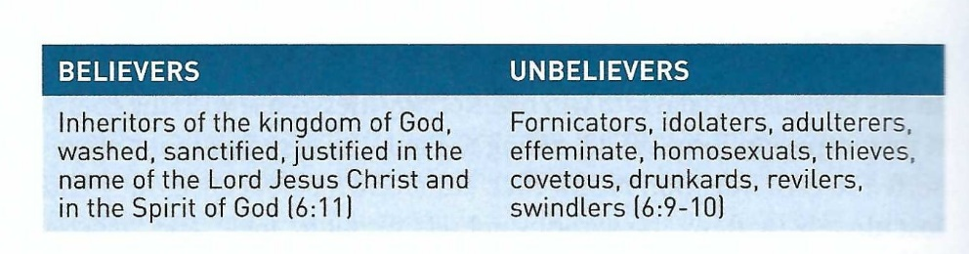
1 Corinthians 6:9-11
In 6:9-11, Paul shifts his strategy to further contrast the values and lifestyles of unbelievers with the status and inheritance of believers.
Notice many of the vices he lists are either sexual in nature or have to do with ill-gotten gain.
This farther strengthen his case that Christians have no business taking their disputes before non-Christians.

Slide 25
1 Corinthians 6:9-11
When Paul states that the wicked will not inherit the kingdom of God, he is not implying that the Corinthians might lose their salvation.
Nowhere in this passage does he accuse them of any of the vices listed here. He explicitly states that some of them used to practices these things prior to their salvation (6:11).
His point is that the believers, indwelled by the Spirit and destined to act as judges in the kingdom, have access to more than enough wisdom to judge civil disputes among themselves.
While secular judges have high positions in the earthly kingdom, they often have sinful lifestyles that could cloud their judgment and disqualify them from settling matters among believers.

Slide 26
Applications
Of the
lesson
Escaping the Legal Swamp

Slide 27
Application – escaping the legal swamp
Swindoll closes this lesson by highlighting some of the over used phrases of our sue-saturated generation . . .
“I’ve got my rights!”
“I’ve got it coming to me!”
“I just want my fair share!”
“I don’t have to take that from you!”
Reminding us that in the legal swamp, children sue their parents. Athletes sue their coaches. Wives sue husbands and employee sue employers.
He says it isn’t limited to unbelievers. Christians are now waist deep in the legal swamp. Christian neighbors sue each other. Christian faculty members are filing suit against the administrations of schools, colleges, and seminaries.

Slide 28
Application – escaping the legal swamp
Churches not only sue one another, but congregations now sue their pastors – and vice versa.
Parishioners who have complaints about the counseling they received from their ministers are turning to the courts to voice their anger and to seek large financial settlements.
Brothers and sisters in the family of God are actually dragging each other through the mire of the legal swamp, often to the exclusion of any attempts at reconciling face to face. You would think 6:1-8, somehow fell out of their Bible.
Let’s not so naïve that we believe we Christians don’t need laws or that we never have reason to complain, or that wolves in sheep’s clothing don’t prey on and exploit flocks.

Slide 29
Application – escaping the legal swamp
We must be discerning, alert, and ever mindful that human depravity must be held in check and such wickedness in our churches must be exposed.
Yet the way we go about it, the spirit with which we do it, the attitudes we exhibit working through the difficult process of reconciliation – is where too often we abandon our Christian values and take up worldly vices like weapons.
Instead of dealing with these things from a spiritual perspective, too often we press the issue from a strictly legal standpoint. Even if we win the case, we don’t walk away humble and grateful.
We walk away proud and emboldened, usually ready to strike the next person or group that crosses us.

Slide 30
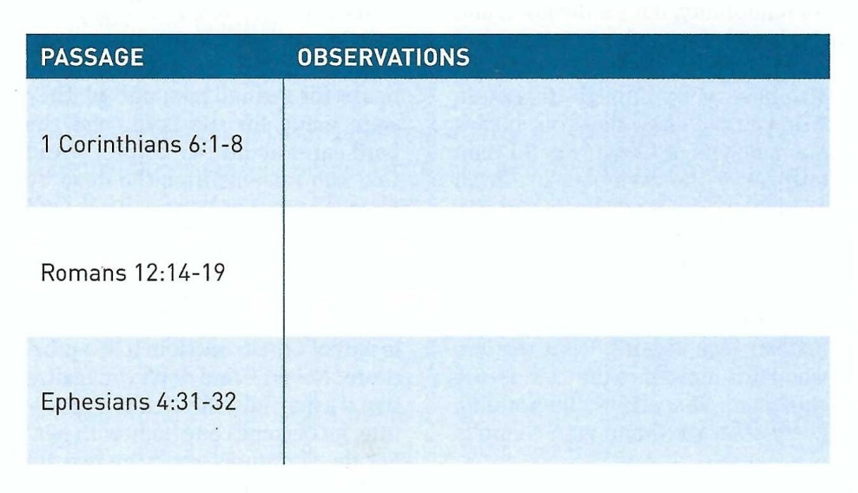
Application – escaping the legal swamp
Swindoll says … Christians today need a reminder about how to resolve disputes in a godly manner.
Then he give us an exercise: study and meditate on the below passages and write down some observations about what God is telling us regarding dispute resolution.

Slide 31
Application – escaping the legal swamp
After completed turn your observations into commands and answer the following questions.
How is God asking us to adjust our worldly attitudes and actions?
How are we to respond to those who offend, harm or betray us?
You’ll discover, that God’s approach is countercultural, radical, and almost unbelievable. It doesn’t come naturally, nor can it be implemented with a stubborn will and a proud spirit.
A Christian approaching conflict resolution biblically, must be willing to listen, to negotiate, to yield, to confess, to forgive, to submit, to release, and ultimately to forget.

Slide 32
Application – escaping the legal swamp
Unselfishness must prevail. That is what brings about the joy of restoration, strengthened relationships, and authentic fellowship.
Humility replaces pride. Thankfulness cancels out arrogance. Mercy flies in the face of resentment. Love never fails. It conquers all.

Slide 33


To Sue or Not to Sue?

Slide 34
NEXT CLASS – 19 July 2023
Book of First Corinthians
Before next class, read the below chapters in the NKJV and in one other versions of the Bible, i.e., KJV, NRSV, NIV, CEV, etc …
Chapter 6:12 – 20
“My Body and Me”

